Slide 1
The Foundations: Logic and Proofs
Chapter 1, Part I: Propositional Logic
With Question/Answer Animations
Copyright © McGraw-Hill Education. All rights reserved. No reproduction or distribution without the prior written consent of McGraw-Hill Education.

Slide 2
Chapter Summary
Propositional Logic
The Language of Propositions
Applications
Logical Equivalences
Predicate Logic
The Language of Quantifiers
Logical Equivalences
Nested Quantifiers
Proofs
Rules of Inference
Proof Methods
Proof Strategy

Slide 3
Propositional Logic Summary
The Language of Propositions
Connectives
Truth Values
Truth Tables
Applications
Translating English Sentences
System Specifications
Logic Puzzles
Logic Circuits
Logical Equivalences
Important Equivalences
Showing Equivalence
Satisfiability

Slide 4
Propositional Logic
Section 1.1

Slide 5
Section Summary
Propositions
Connectives
Negation
Conjunction
Disjunction
Implication; contrapositive, inverse, converse
Biconditional
Truth Tables

Slide 6
Propositions
A proposition is a declarative sentence that is either true or false.
Examples of propositions:
The Moon is made of green cheese.
Trenton is the capital of New Jersey.
Toronto is the capital of Canada.
1 + 0 = 1
0 + 0 = 2
Examples that are not propositions.
Sit down!
What time is it?
x + 1 = 2
x + y = z

Slide 7
Propositional Logic
Constructing Propositions
Propositional Variables: p, q, r, s, …
The proposition that is always true is denoted by T and the proposition that is always false is denoted by F.
Compound Propositions; constructed from logical connectives and other propositions
Negation ¬
Conjunction ∧
Disjunction ∨
Implication →
Biconditional ↔

Slide 8
Compound Propositions: Negation
The negation of a proposition p is denoted by ¬p and has this truth table:
Example: If p denotes “The earth is round.”, then ¬p denotes “It is not the case that the earth is round,” or more simply “The earth is not round.”
p | ¬p
T | F
F | T

Slide 9
Conjunction
The conjunction of propositions p and q is denoted by p ∧ q and has this truth table:
Example: If p denotes “I am at home.” and q denotes “It is raining.” then p ∧q denotes “I am at home and it is raining.”
p | q | p ∧ q
T | T | T
T | F | F
F | T | F
F | F | F

Slide 10
Disjunction
The disjunction of propositions p and q is denoted by p ∨q and has this truth table:
Example: If p denotes “I am at home.” and q denotes “It is raining.” then p ∨q denotes “I am at home or it is raining.”
p | q | p ∨q
T | T | T
T | F | T
F | T | T
F | F | F

Slide 11
The Connective Or in English
In English “or” has two distinct meanings.
“Inclusive Or” - In the sentence “Students who have taken CS202 or Math120 may take this class,” we assume that students need to have taken one of the prerequisites, but may have taken both. This is the meaning of disjunction. For p ∨q to be true, either one or both of p and q must be true.
“Exclusive Or” - When reading the sentence “Soup or salad comes with this entrée,” we do not expect to be able to get both soup and salad. This is the meaning of Exclusive Or (Xor). In p ⊕ q , one of p and q must be true, but not both. The truth table for ⊕ is:
p | q | p ⊕q
T | T | F
T | F | T
F | T | T
F | F | F

Slide 12
Implication
If p and q are propositions, then p →q is a conditional statement or implication which is read as “if p, then q ” and has this truth table:
Example: If p denotes “I am at home.” and q denotes “It is raining.” then p →q denotes “If I am at home then it is raining.”
In p →q , p is the hypothesis (antecedent or premise) and q is the conclusion (or consequence).
p | q | p →q
T | T | T
T | F | F
F | T | T
F | F | T

Slide 13
Understanding Implication
In p →q there does not need to be any connection between the antecedent or the consequent. The “meaning” of p →q depends only on the truth values of p and q.
These implications are perfectly fine, but would not be used in ordinary English.
“If the moon is made of green cheese, then I have more money than Bill Gates. ”
“If the moon is made of green cheese then I’m on welfare.”
“If 1 + 1 = 3, then your grandma wears combat boots.”

Slide 14
Understanding Implication (cont)
One way to view the logical conditional is to think of an obligation or contract.
“If I am elected, then I will lower taxes.”
“If you get 100% on the final, then you will get an A.”
If the politician is elected and does not lower taxes, then the voters can say that he or she has broken the campaign pledge. Something similar holds for the professor. This corresponds to the case where p is true and q is false.

Slide 15
Different Ways of Expressing p →q
if p, then q p implies q
if p, q p only if q
q unless ¬p q when p
q if p
q whenever p p is sufficient for q
q follows from p q is necessary for p
a necessary condition for p is q
a sufficient condition for q is p

Slide 16
Converse, Contrapositive, and Inverse
From p →q we can form new conditional statements .
q →p is the converse of p →q
¬q → ¬ p is the contrapositive of p →q
¬ p → ¬ q is the inverse of p →q
Example: Find the converse, inverse, and contrapositive of “It raining is a sufficient condition for my not going to town.”
Solution:
converse: ?
inverse: ?
contrapositive: ?

Slide 17
Converse, Contrapositive, and Inverse
From p →q we can form new conditional statements .
q →p is the converse of p →q
¬q → ¬ p is the contrapositive of p →q
¬ p → ¬ q is the inverse of p →q
Example: Find the converse, inverse, and contrapositive of “It raining is a sufficient condition for my not going to town.”
Solution:
converse: If I do not go to town, then it is raining.
inverse: If it is not raining, then I will go to town.
contrapositive: If I go to town, then it is not raining.

Slide 18
Biconditional
If p and q are propositions, then we can form the biconditional proposition p ↔q , read as “p if and only if q .” The biconditional p ↔q denotes the proposition with this truth table:
If p denotes “I am at home.” and q denotes “It is raining.” then p ↔q denotes “I am at home if and only if it is raining.”
p | q | p ↔q
T | T | T
T | F | F
F | T | F
F | F | T

Slide 19
Expressing the Biconditional
Some alternative ways “p if and only if q” is expressed in English:
p is necessary and sufficient for q
if p then q , and conversely
p iff q

Slide 20
Truth Tables For Compound Propositions
Construction of a truth table:
Rows
Need a row for every possible combination of values for the atomic propositions.
Columns
Need a column for the compound proposition (usually at far right)
Need a column for the truth value of each expression that occurs in the compound proposition as it is built up.
This includes the atomic propositions

Slide 21
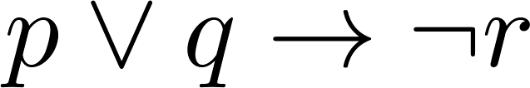
Example Truth Table
Construct a truth table for
p | q | r | ¬r | p ∨ q | p ∨ q → ¬r
T | T | T | F | T | F
T | T | F | T | T | T
T | F | T | F | T | F
T | F | F | T | T | T
F | T | T | F | T | F
F | T | F | T | T | T
F | F | T | F | F | T
F | F | F | T | F | T

Slide 22
Equivalent Propositions
Two propositions are equivalent if they always have the same truth value.
Example: Show using a truth table that the conditional is equivalent to the contrapositive.
Solution:

Slide 23
Equivalent Propositions
Two propositions are equivalent if they always have the same truth value.
Example: Show using a truth table that the conditional is equivalent to the contrapositive.
Solution:
p | q | ¬ p | ¬ q | p →q | ¬q → ¬ p
T | T | F | F | T | T
T | F | F | T | F | F
F | T | T | F | T | T
F | F | T | T | T | T

Slide 24
Using a Truth Table to Show Non-Equivalence
Example: Show using truth tables that neither the converse nor inverse of an implication are not equivalent to the implication.
Solution:
p | q | ¬ p | ¬ q | p →q | ¬ p →¬ q | q → p
T | T | F | F | T | T | T
T | F | F | T | F | T | T
F | T | T | F | T | F | F
F | F | T | T | T | T | T

Slide 25
Problem
How many rows are there in a truth table with n propositional variables?
Solution: ?

Slide 26
Problem
How many rows are there in a truth table with n propositional variables?
Solution: 2^{n} We will see how to do this in Chapter 6.
Note that this means that with n propositional variables, we can construct 2^{n} distinct (i.e., not equivalent) propositions.

Slide 27
Precedence of Logical Operators
Operator | Precedence
¬ | 1
∧ ∨ | 2 3
→ ↔ | 4 5
p ∨q → ¬r is equivalent to (p ∨q) → ¬r
If the intended meaning is p ∨(q → ¬r )
then parentheses must be used.

Slide 28
Applications of Propositional Logic
Section 1.2

Slide 29
Applications of Propositional Logic: Summary
Translating English to Propositional Logic
System Specifications
Boolean Searching
Logic Puzzles
Logic Circuits
AI Diagnosis Method (Optional)

Slide 30
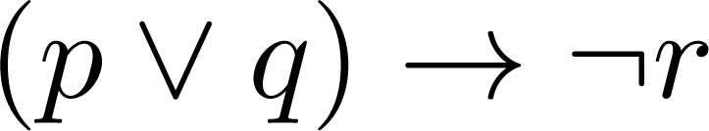
Translating English Sentences
Steps to convert an English sentence to a statement in propositional logic
Identify atomic propositions and represent using propositional variables.
Determine appropriate logical connectives
“If I go to Harry’s or to the country, I will not go shopping.”
p: I go to Harry’s
q: I go to the country.
r: I will go shopping.
If p or q then not r.

Slide 31
Example
Problem: Translate the following sentence into propositional logic:
“You can access the Internet from campus only if you are a computer science major or you are not a freshman.”
One Solution:

Slide 32
Example
Problem: Translate the following sentence into propositional logic:
“You can access the Internet from campus only if you are a computer science major or you are not a freshman.”
One Solution: Let a, c, and f represent respectively “You can access the internet from campus,” “You are a computer science major,” and “You are a freshman.”
a→ (c ∨ ¬ f )

Slide 33
System Specifications
System and Software engineers take requirements in English and express them in a precise specification language based on logic.
Example: Express in propositional logic:
“The automated reply cannot be sent when the file system is full”
Solution: ?

Slide 34
System Specifications
System and Software engineers take requirements in English and express them in a precise specification language based on logic.
Example: Express in propositional logic:
“The automated reply cannot be sent when the file system is full”
Solution: One possible solution: Let p denote “The automated reply can be sent” and q denote “The file system is full.”
q→ ¬ p

Slide 35
Consistent System Specifications
Definition: A list of propositions is consistent if it is possible to assign truth values to the proposition variables so that each proposition is true.
Exercise: Are these specifications consistent?
“The diagnostic message is stored in the buffer or it is retransmitted.”
“The diagnostic message is not stored in the buffer.”
“If the diagnostic message is stored in the buffer, then it is retransmitted.”
Solution: Let p denote “The diagnostic message is stored in the buffer.” Let q denote “The diagnostic message is retransmitted” The specification can be written as: p ∨ q, ¬p, p → q. When p is false and q is true all three statements are true. So the specification is consistent.
What if “The diagnostic message is not retransmitted is added.”
Solution: Now we are adding ¬q and there is no satisfying assignment. So the specification is not consistent.

Slide 36
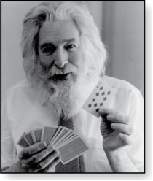
Logic Puzzles
Raymond Smullyan
(Born 1919)
An island has two kinds of inhabitants, knights, who always tell the truth, and knaves, who always lie.
You go to the island and meet A and B.
A says “B is a knight.”
B says “The two of us are of opposite types.”
Example: What are the types of A and B?
Solution: ?

Slide 37
Logic Puzzles
Raymond Smullyan
(Born 1919)
An island has two kinds of inhabitants, knights, who always tell the truth, and knaves, who always lie.
You go to the island and meet A and B.
A says “B is a knight.”
B says “The two of us are of opposite types.”
Example: What are the types of A and B?
Solution: Let p and q be the statements that A is a knight and B is a knight, respectively. So, then ¬p represents the proposition that A is a knave and ¬q that B is a knave.
If A is a knight, then p is true. Since knights tell the truth, q must also be true. Then (p ∧ ¬ q)∨ (¬ p ∧ q) would have to be true, but it is not. So, A is not a knight and therefore ¬p must be true.
If A is a knave, then B must not be a knight since knaves always lie. So, then both ¬p and ¬q hold since both are knaves.

Slide 38
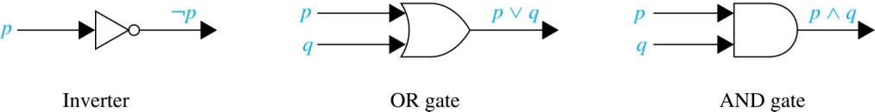
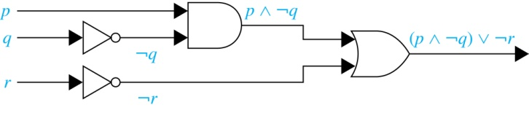
Logic Circuits (Studied in depth in Chapter 12)
Electronic circuits; each input/output signal can be viewed as a 0 or 1.
0 represents False
1 represents True
Complicated circuits are constructed from three basic circuits called gates.
The inverter (NOT gate)takes an input bit and produces the negation of that bit.
The OR gate takes two input bits and produces the value equivalent to the disjunction of the two bits.
The AND gate takes two input bits and produces the value equivalent to the conjunction of the two bits.
More complicated digital circuits can be constructed by combining these basic circuits to produce the desired output given the input signals by building a circuit for each piece of the output expression and then combining them. For example:

Slide 39
Propositional Equivalences
Section 1.3

Slide 40
Section Summary
Tautologies, Contradictions, and Contingencies.
Logical Equivalence
Important Logical Equivalences
Showing Logical Equivalence
Normal Forms (optional, covered in exercises in text)
Disjunctive Normal Form
Conjunctive Normal Form
Propositional Satisfiability
Sudoku Example

Slide 41
Tautologies, Contradictions, and Contingencies
A tautology is a proposition which is always true.
Example: p ∨¬p
A contradiction is a proposition which is always false.
Example: p ∧¬p
A contingency is a proposition which is neither a tautology nor a contradiction, such as p
P | ¬p | p ∨¬p | p ∧¬p
T | F | T | F
F | T | T | F

Slide 42
Logically Equivalent
Two compound propositions p and q are logically equivalent if p↔q is a tautology.
We write this as p⇔q or as p≡q where p and q are compound propositions.
Two compound propositions p and q are equivalent if and only if the columns in a truth table giving their truth values agree.
This truth table shows that ¬p ∨ q is equivalent to p → q.
p | q | ¬p | ¬p ∨ q | p→ q
T | T | F | T | T
T | F | F | F | F
F | T | T | T | T
F | F | T | T | T

Slide 43
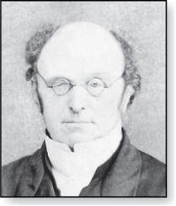
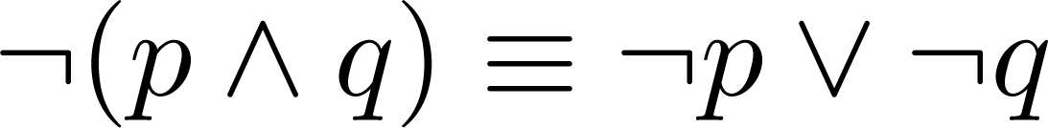
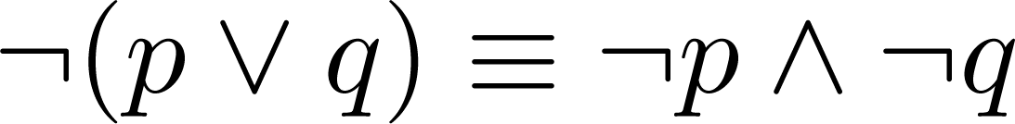
De Morgan’s Laws
Augustus De Morgan
1806-1871
This truth table shows that De Morgan’s Second Law holds.
p | q | ¬p | ¬q | (p∨q) | ¬(p∨q) | ¬p∧¬q
T | T | F | F | T | F | F
T | F | F | T | T | F | F
F | T | T | F | T | F | F
F | F | T | T | F | T | T

Slide 44
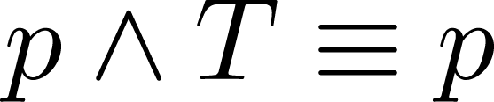
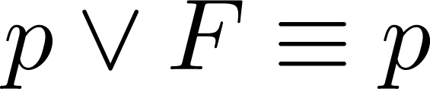
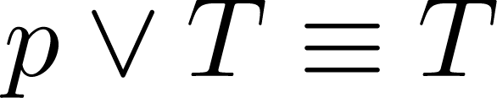
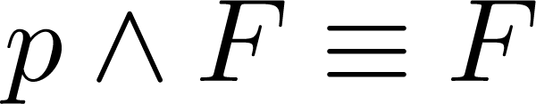
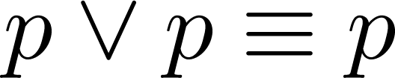
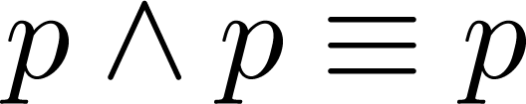
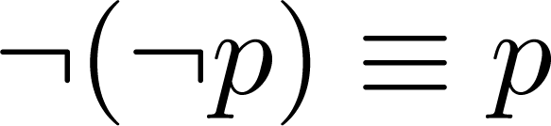
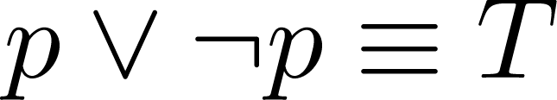
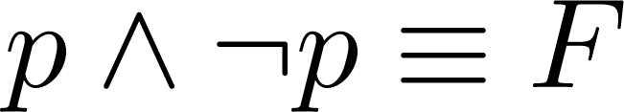
Key Logical Equivalences
Identity Laws: ,
Domination Laws: ,
Idempotent laws: ,
Double Negation Law:
Negation Laws: ,

Slide 45
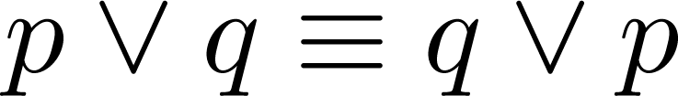
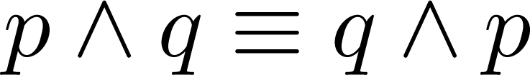
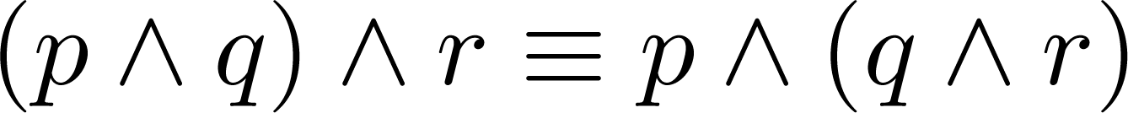
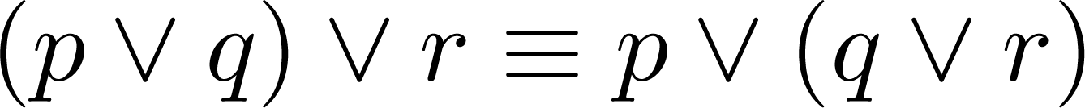
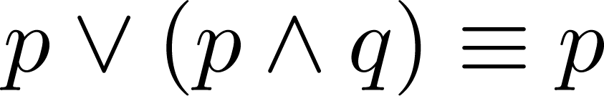
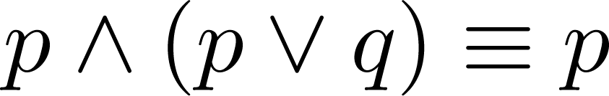
Key Logical Equivalences (cont)
Commutative Laws: ,
Associative Laws:
Distributive Laws:
Absorption Laws:

Slide 46
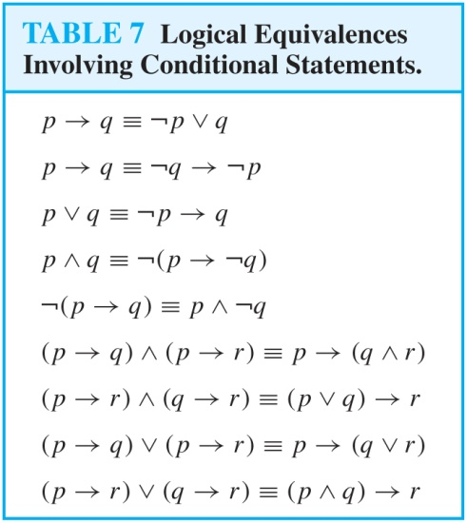
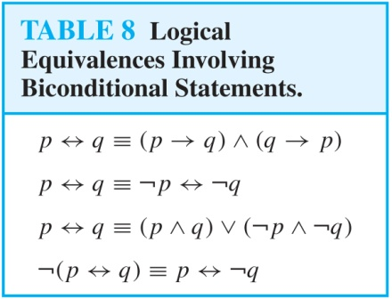
More Logical Equivalences

Slide 47


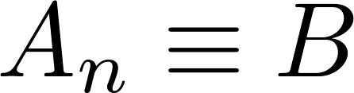
Constructing New Logical Equivalences
We can show that two expressions are logically equivalent by developing a series of logically equivalent statements.
To prove that we produce a series of equivalences beginning with A and ending with B.
Keep in mind that whenever a proposition (represented by a propositional variable) occurs in the equivalences listed earlier, it may be replaced by an arbitrarily complex compound proposition.

Slide 48
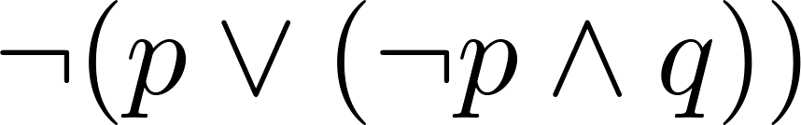
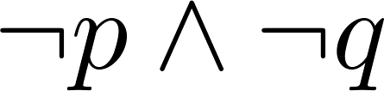
Equivalence Proofs
Example: Show that
is logically equivalent to
Solution:

Slide 49
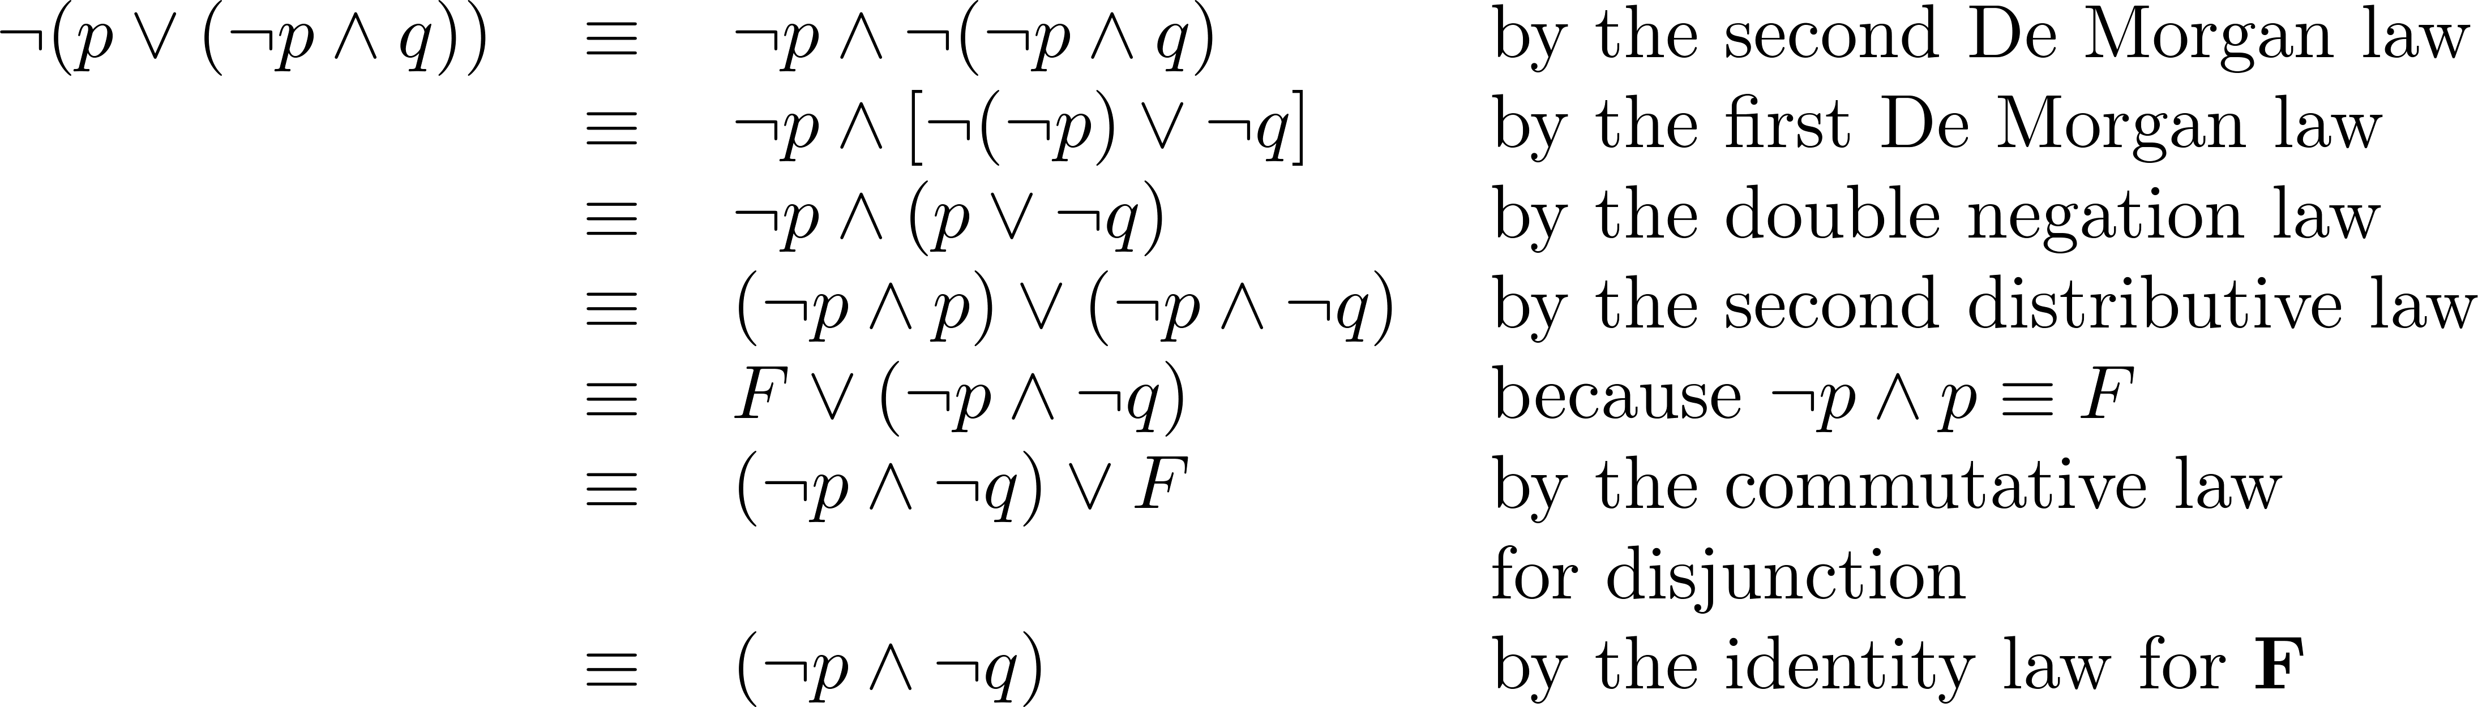
Equivalence Proofs
Example: Show that
is logically equivalent to
Solution:

Slide 50
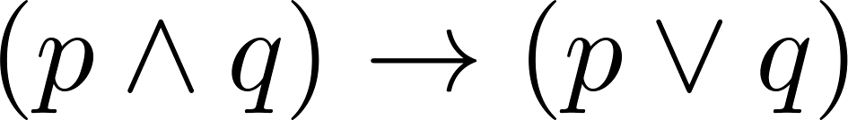
Equivalence Proofs
Example: Show that
is a tautology.
Solution:

Slide 51
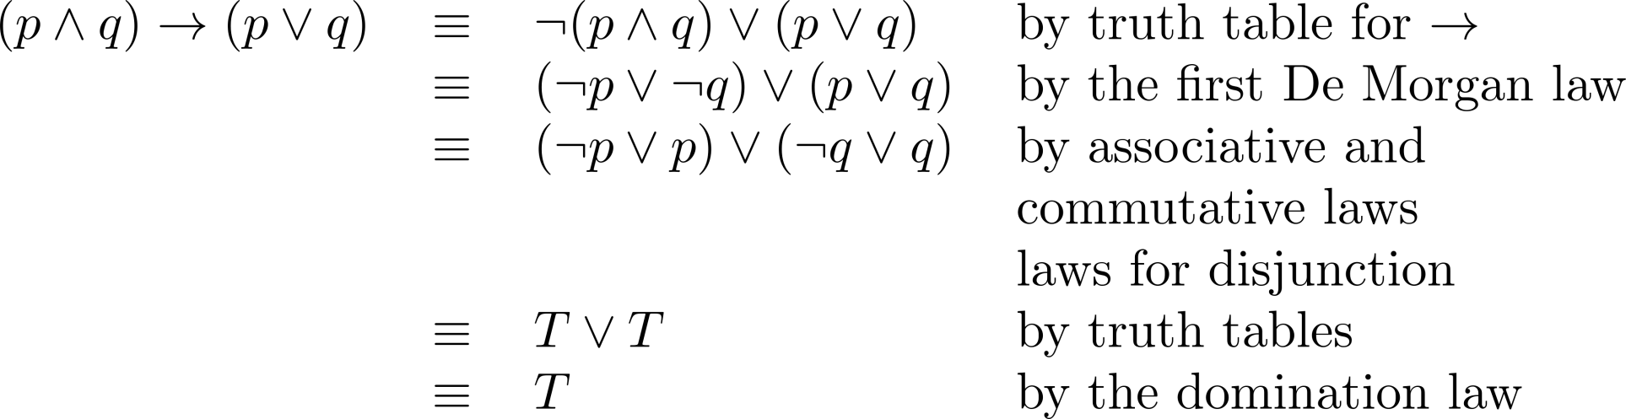
Equivalence Proofs
Example: Show that
is a tautology.
Solution:

